Slide 1
Basic signals
Why use complex exponentials?
  Because they are useful building blocks which can be used to represent large and useful classes of signals
  Response of LTI systems to these basic signals is particularly simple and useful.
a_{k}e^{jkω}0 ^{t}
h(t)
a_{k} H(jkω₀) e^{jω}0 ^{t}
Complex scaling factor

Slide 2
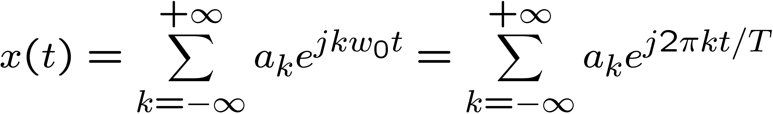
Fourier Series Representation of CT Periodic Signals
x(t) = x(t+T) for all t
  Smallest such T is the fundamental period
  ω₀ = 2π/T is the fundamental frequency
e^{jωt} periodic with period T ⬄ ω = kω₀
⇓
  Periodic with period T
  {a_{k}} are the Fourier (series) coefficients
  k = 0 DC
  k = ±1 first harmonic
  k = ±2 second harmonic

Slide 3
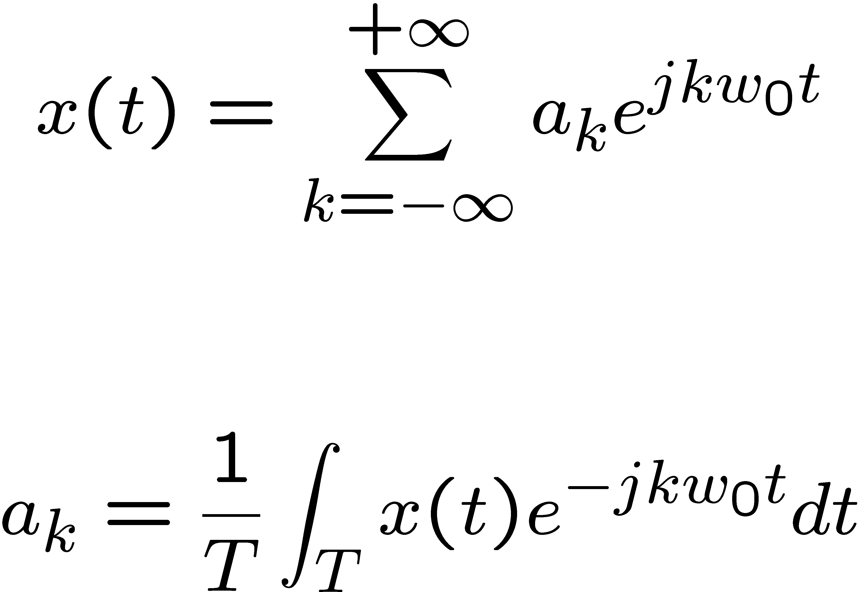
CT Fourier Series Pair
(Synthesis Equation)
(Analysis Equation)

Slide 4
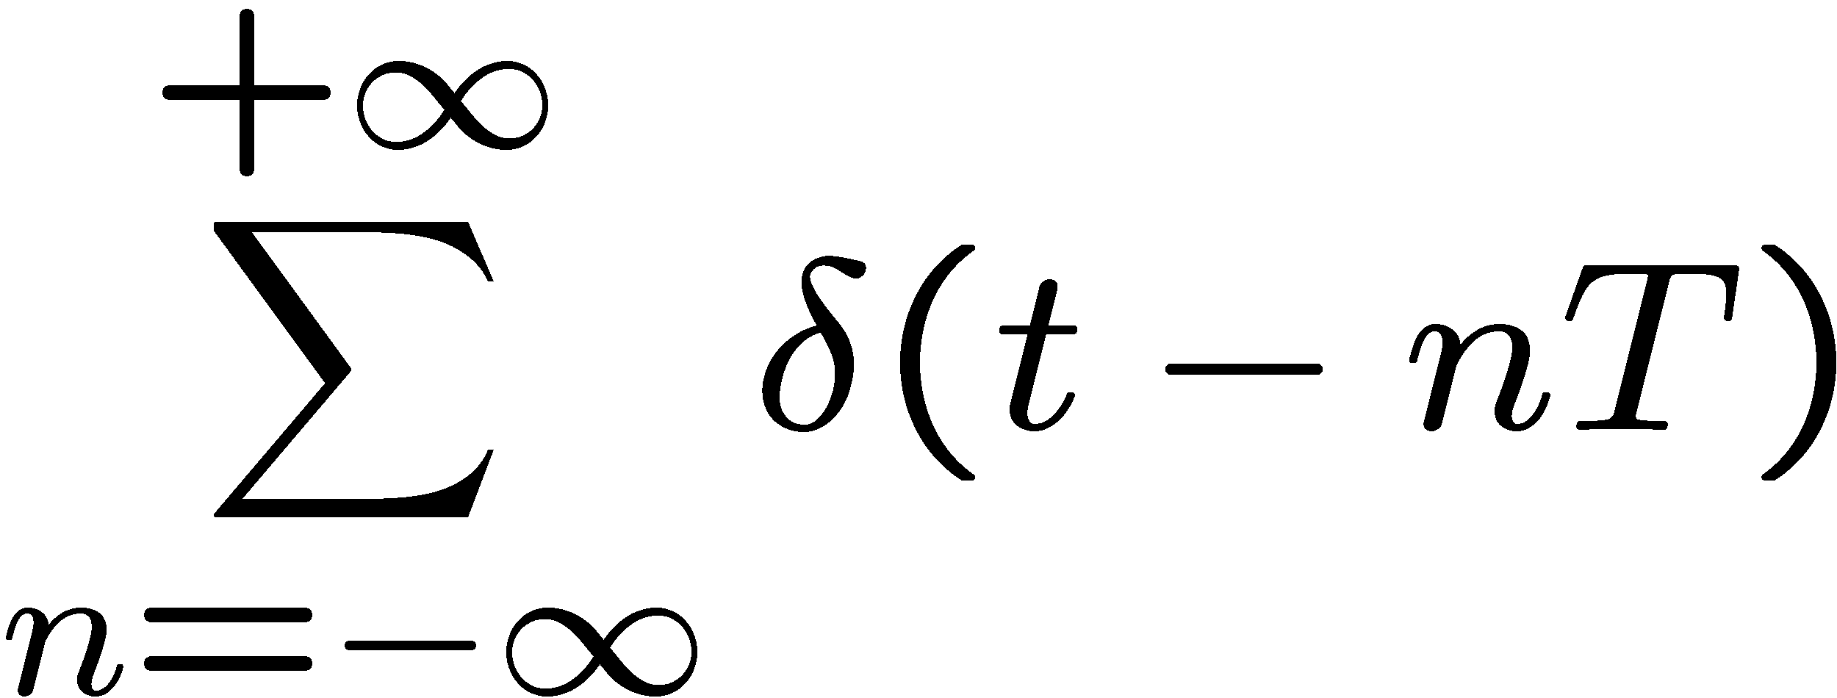
Examples
x(t) = cos(4πt) + 2sin(8πt)
Periodic square wave (from lecture)
Periodic impulse train

Slide 5
Even and Odd Functions
Even functions are defined by the property:
f(x) = f(-x)
Odd functions are defined by the property:
f(x) = -f(-x)

Slide 6
Some notes on CT Fourier series
For k = 0, a₀ = s_{T} x(t) dt ← mean value over the period (DC term)
If x(t) is real, a_{k} = a*_{-k}
If x(t) is even, a_{k} = a_{-k}
If x(t) is odd, a_{k} = -a_{-k}
If x(t) is real and even, a_{k} = a*_{-k} = a_{-k} → a_{k}’s will only have real terms
If x(t) is real and odd, a_{k} = a*_{-k} = -a_{-k} → a_{k}’s will only have odd terms

Slide 7
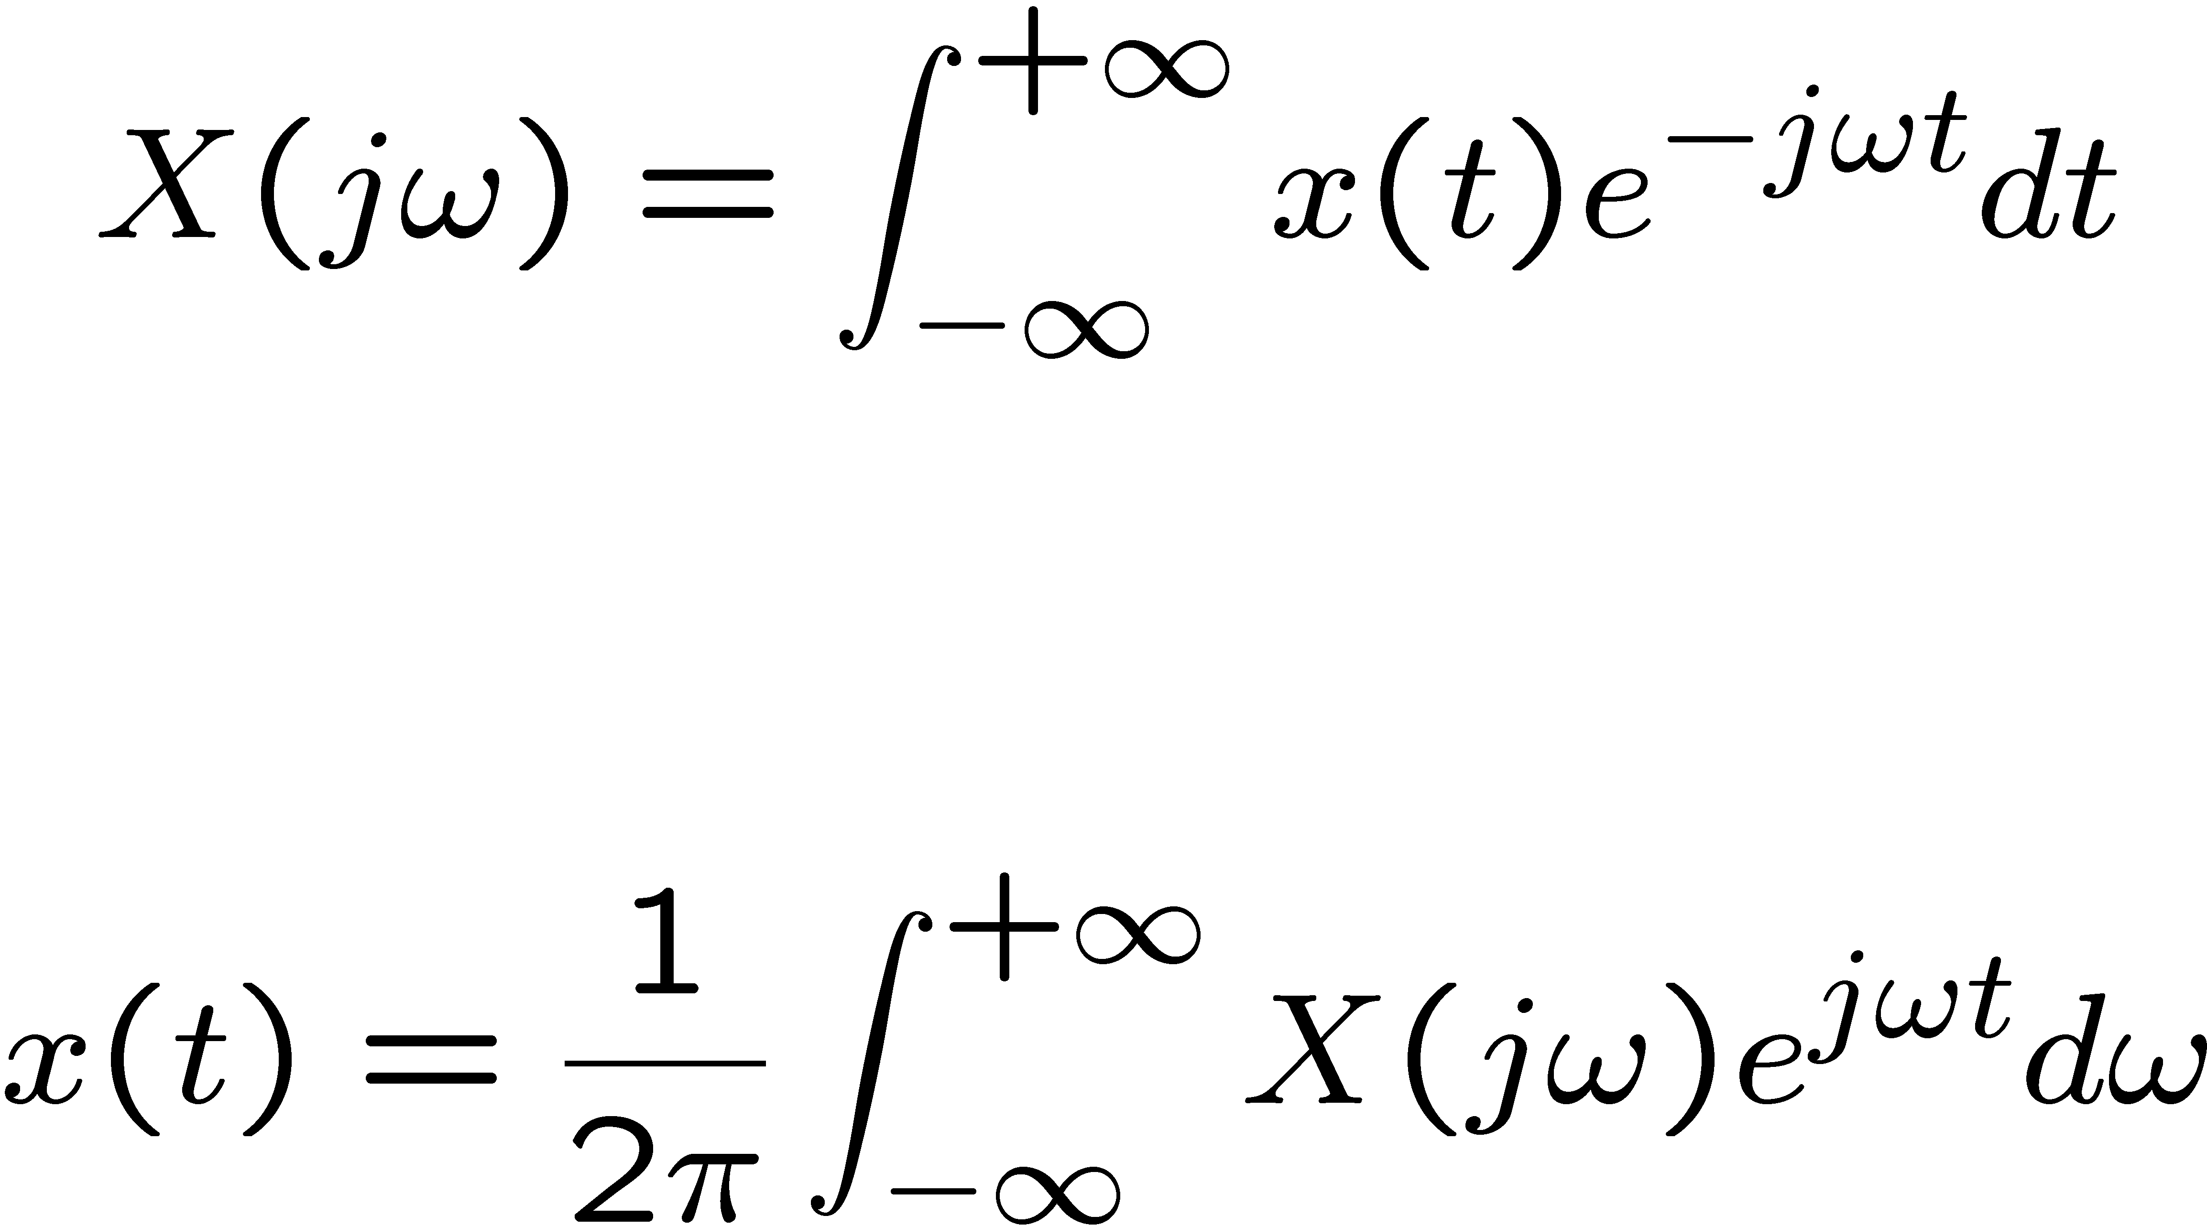
The CT Fourier Transform Pair
x(t) ↔ X(jω)

