Slide 1
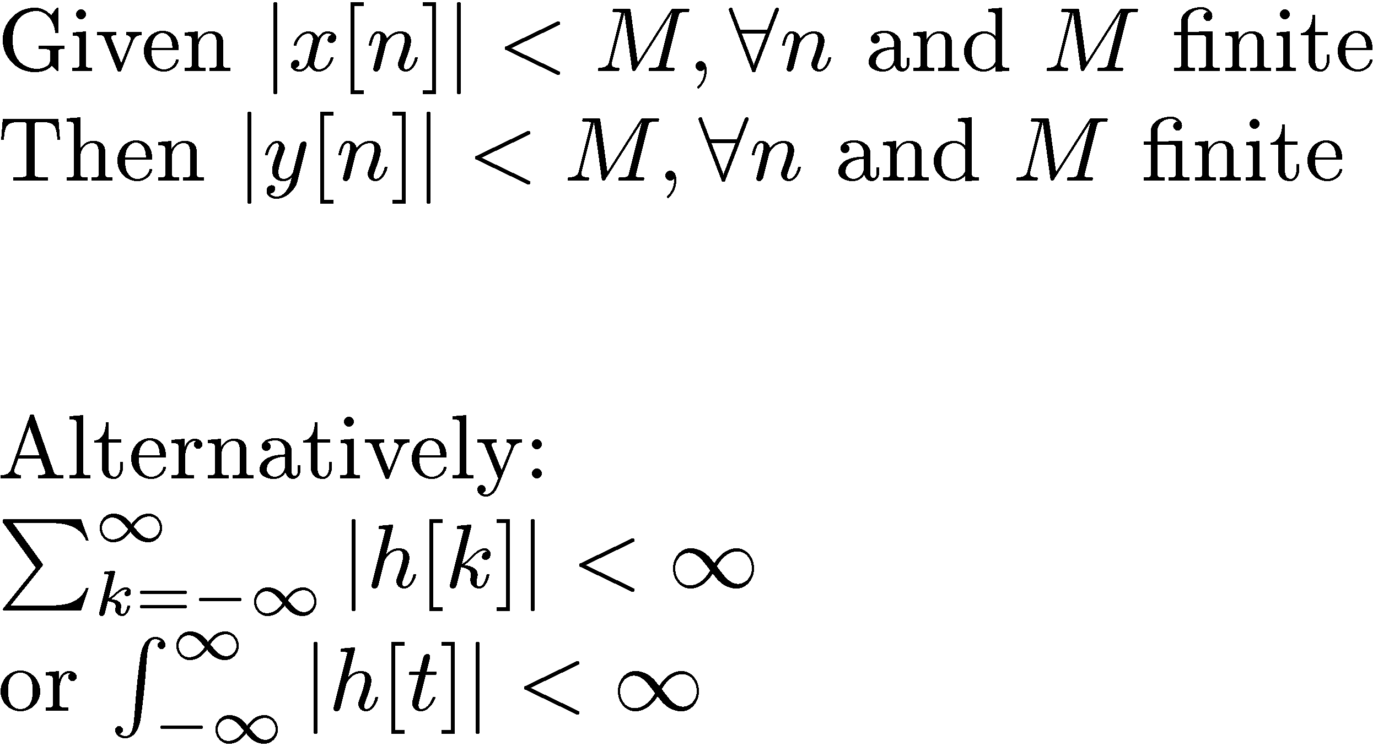
Stability
Bounded input → bounded output
Absolutely summable
Absolutely integrable

Slide 2
Stability
Examples:
  y(t) = 2^{t} Unstable
  y(t) = x²(t) Stable
  y(t) = 2^{t} x(0) Unstable
  y(t) = 2^{t} x(t) Unstable
  y(t) = (1/2)^{t} x(t) Unstable, t→ -1 blows up, y(t) = (1/2)^{t} u(t) is stable

Slide 3
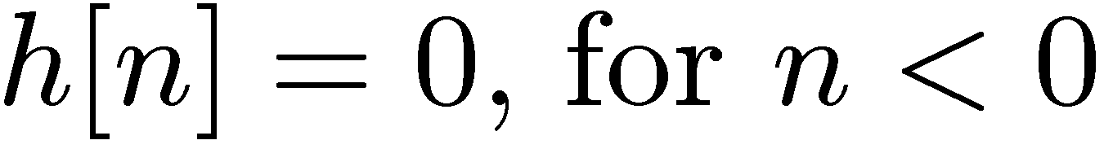
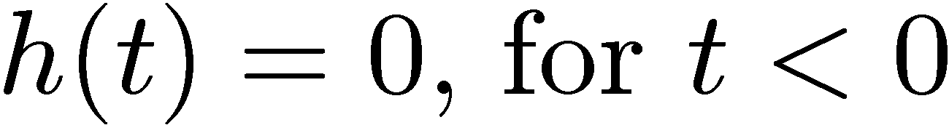
Causality
Output does not depend on future values of the input:
Examples
  y(t) = x(t+1) Not Causal
  y(t) = x(t) e^{t+1} Causal
  y[n] = x[n] + x[n+1] Not Causal

