Slide 1
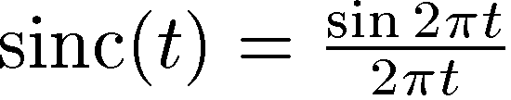
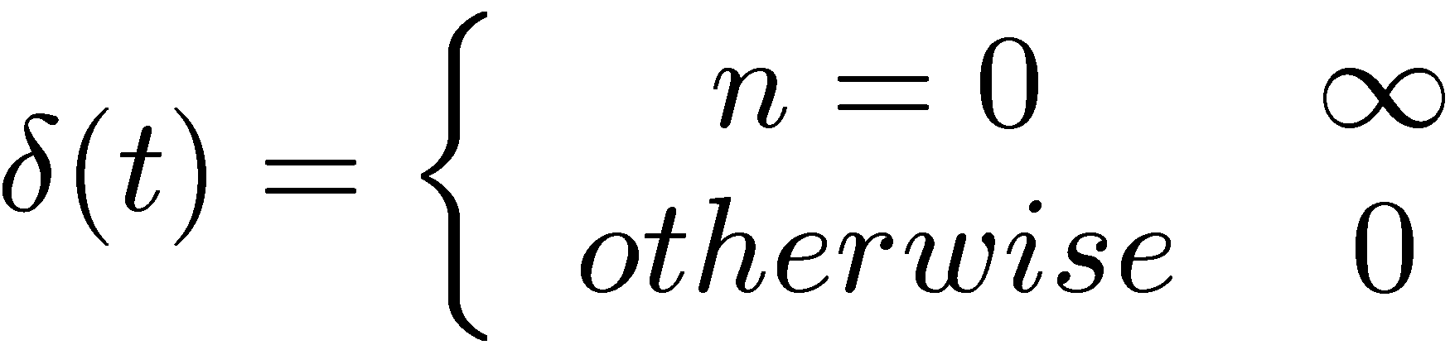
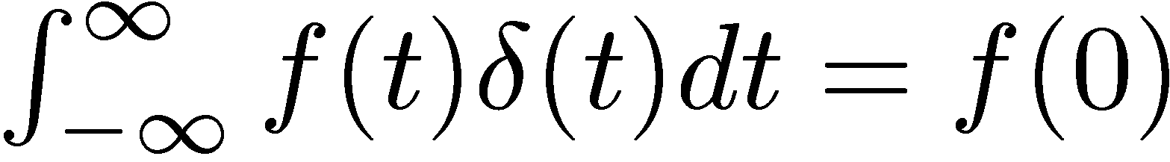
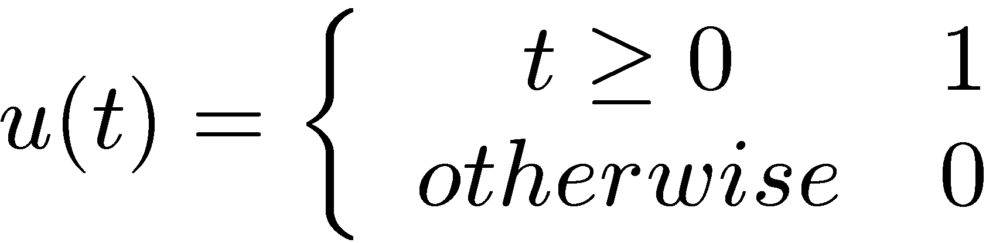
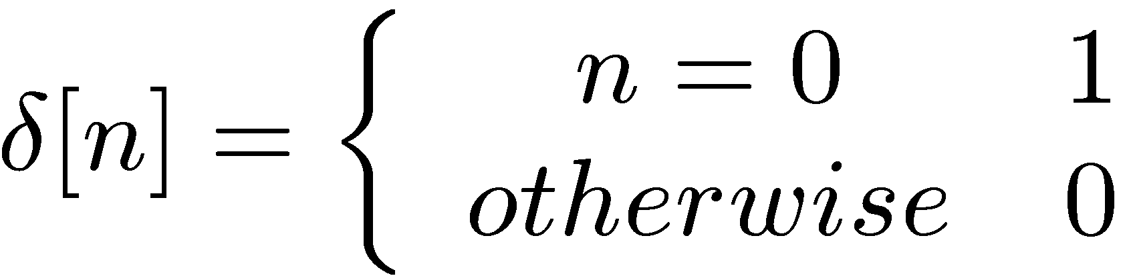
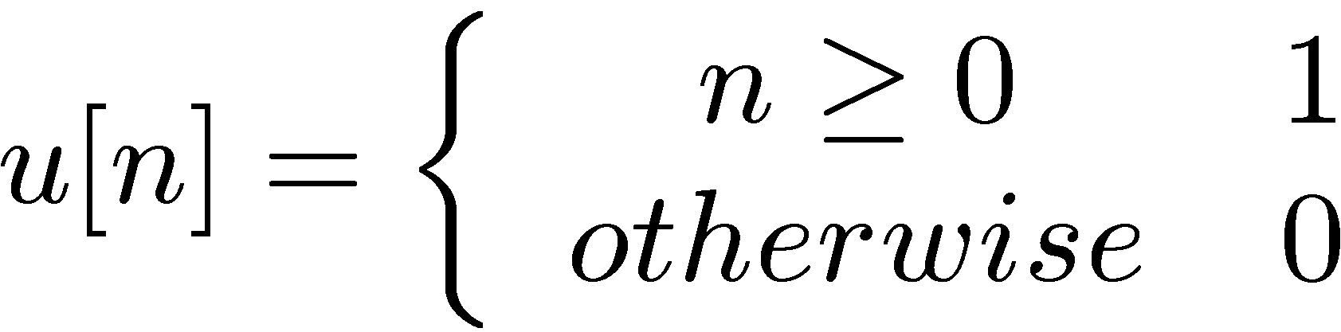
Special signals:
Sinc:
Delta function:
Unit step (CT):
Unit sample:
Unit step (DT):
Note: δ[t] = d/dt u[t] and d[n] = u[n] – u[n-1]

Slide 2
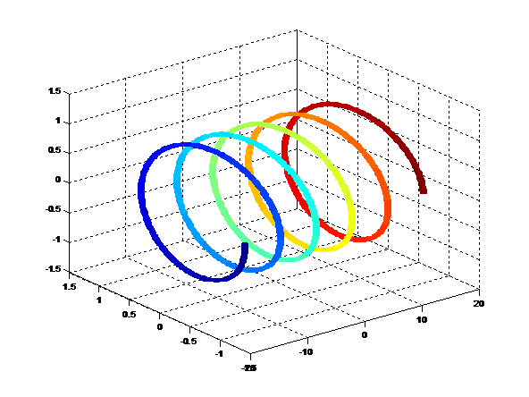
Special signals:
Complex exponentials
Imaginary
Real
Time

